Slide 1

CHAPTER 10
THEORY OF GRAPHS AND TREES
Copyright © Cengage Learning. All rights reserved.

Slide 2

10.6
Spanning Trees and a Shortest Path Algorithm
Copyright © Cengage Learning. All rights reserved.

Slide 3
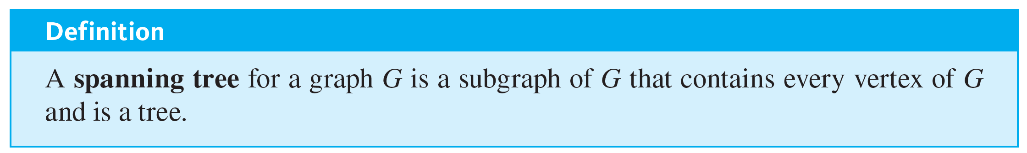
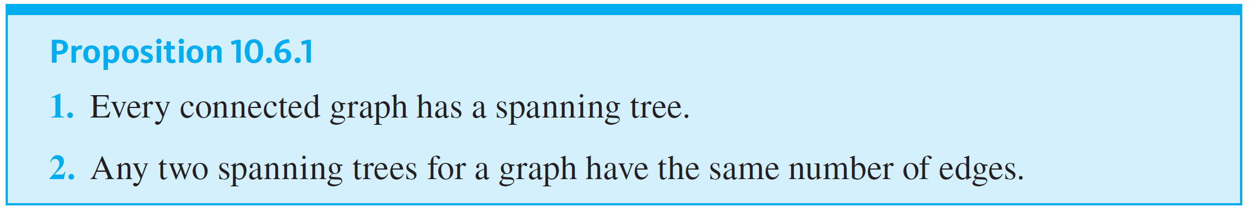
Spanning Trees and a Shortest Path Algorithm

Slide 4
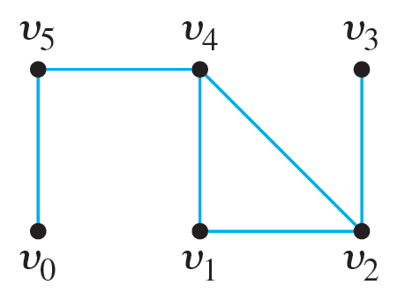
Example 10.6.1 – Spanning Trees
Find all spanning trees for the graph G pictured below.

Slide 5
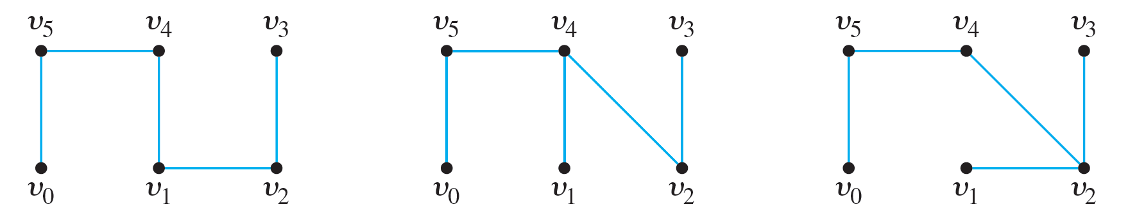
Example 10.6.1 – Solution
The graph G has one circuit v₂v₁v₄v₂, and removing any edge of the circuit gives a tree. Thus, as shown below, there are three spanning trees for G.

Slide 6
Minimum Spanning Trees

Slide 7
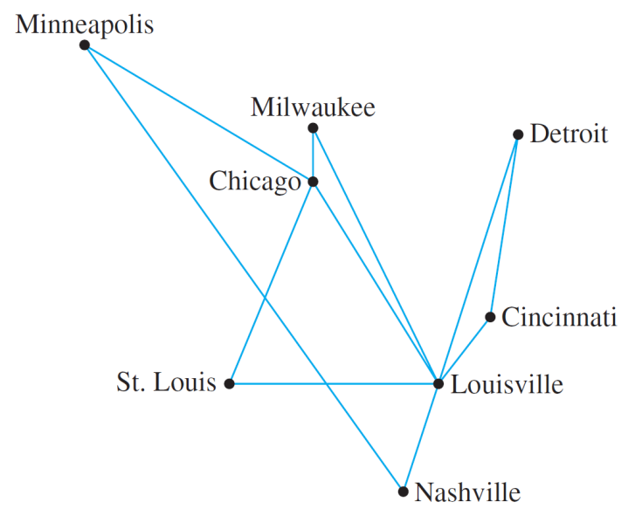
Minimum Spanning Trees
The graph of the routes allowed by the U.S. Federal Aviation Authority shown in Figure 10.6.1 can be annotated by adding the distances (in miles) between each pair of cities.
Figure 10.6.1

Slide 8
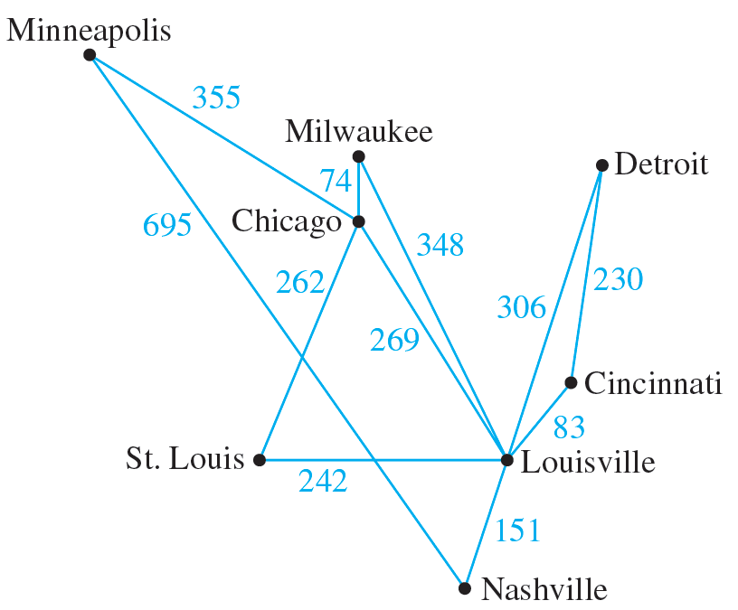
Minimum Spanning Trees
This is done in Figure 10.6.3.
Figure 10.6.3

Slide 9
Minimum Spanning Trees
Now suppose the airline company wants to serve all the cities shown, but with a route system that minimizes the total mileage of the system as a whole.
Note that such a system is a tree, because if the system contained a circuit, removal of an edge from the circuit would not affect a person’s ability to reach every city in the system from every other, but it would reduce the total mileage of the system.

Slide 10
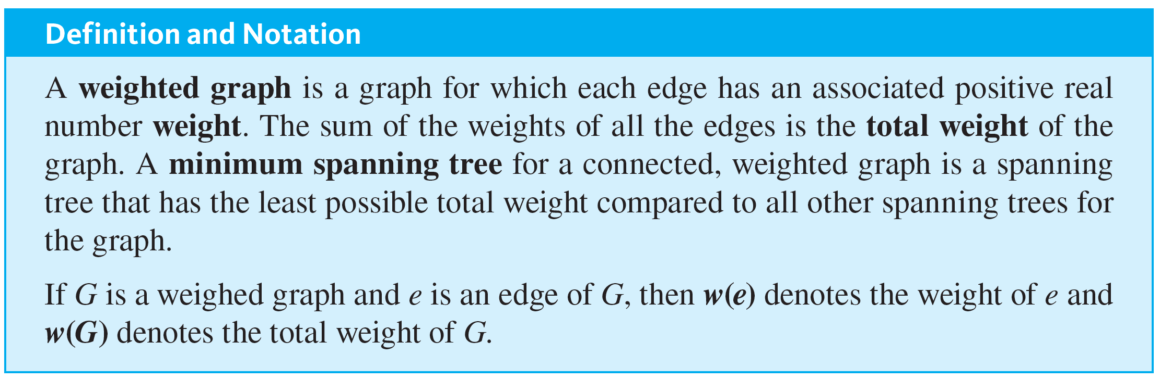
Minimum Spanning Trees
More generally, a graph whose edges are labeled with numbers (known as weights) is called a weighted graph. A minimum-weight spanning tree, or simply a minimum spanning tree, is a spanning tree for which the sum of the weights of all the edges is as small as possible.

Slide 11
Kruskal’s Algorithm

Slide 12
Kruskal’s Algorithm
In Kruskal’s algorithm, the edges of a connected, weighted graph are examined one by one in order of increasing weight. At each stage the edge being examined is added to what will become the minimum spanning tree, provided that this addition does not create a circuit.
After n − 1 edges have been added (where n is the number of vertices of the graph), these edges, together with the vertices of the graph, form a minimum spanning tree for the graph.

Slide 13
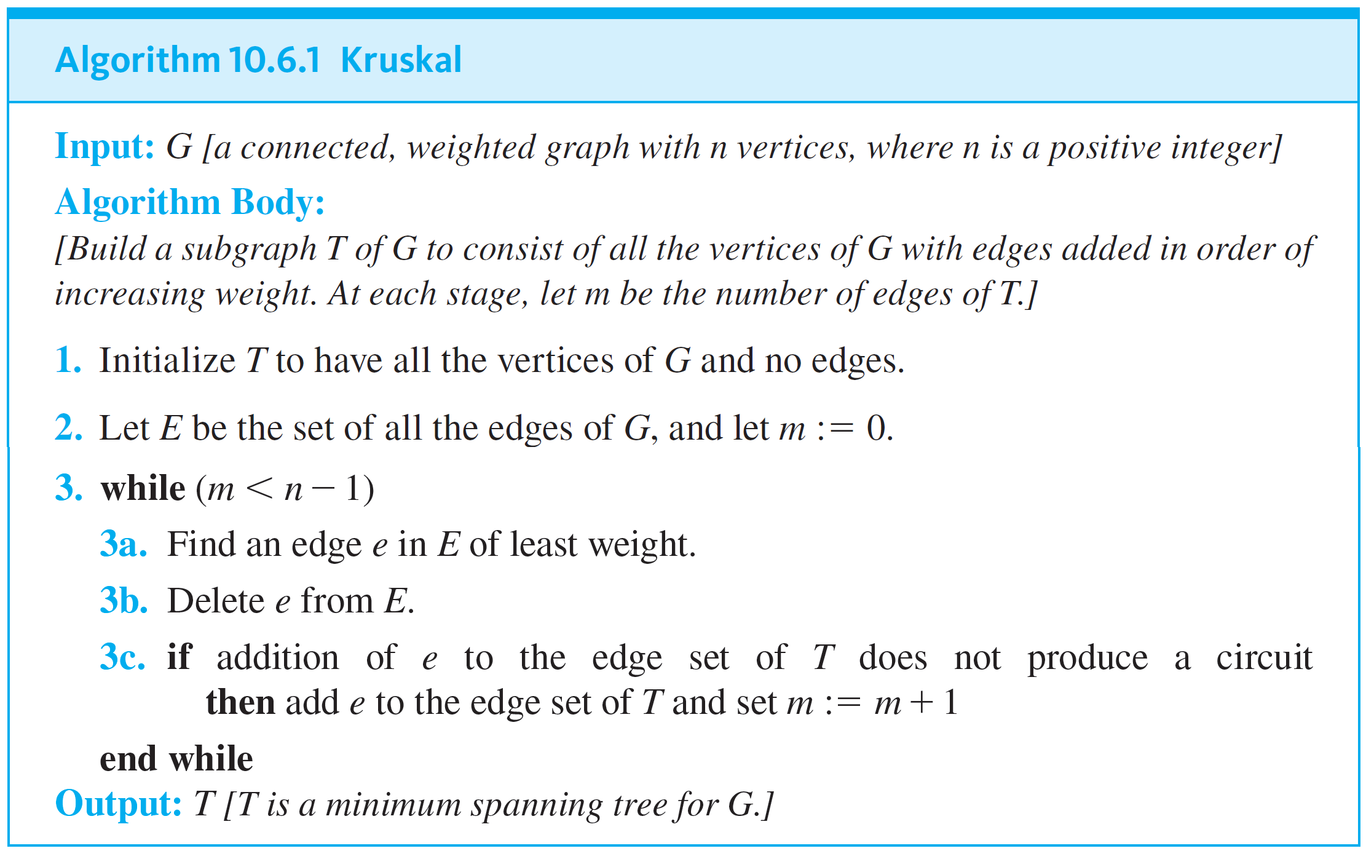
Kruskal’s Algorithm

Slide 14
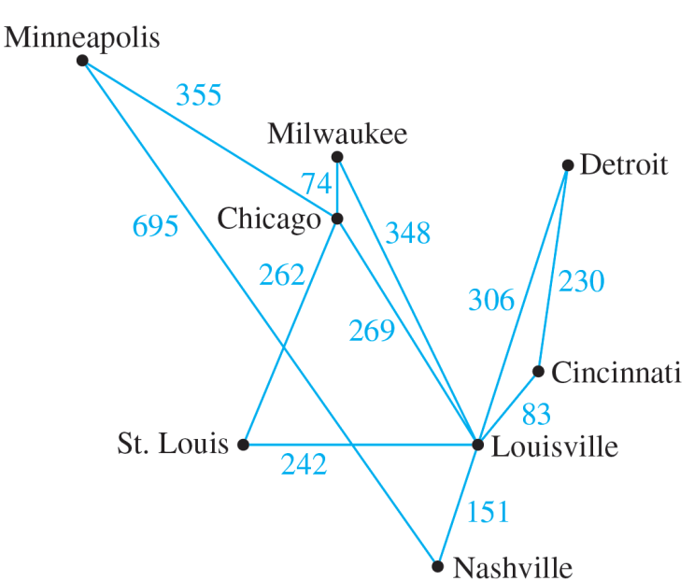
Example 10.6.2 – Action of Kruskal’s Algorithm
Describe the action of Kruskal’s algorithm on the graph shown in Figure 10.6.4, where n = 8.
Figure 10.6.4

Slide 15
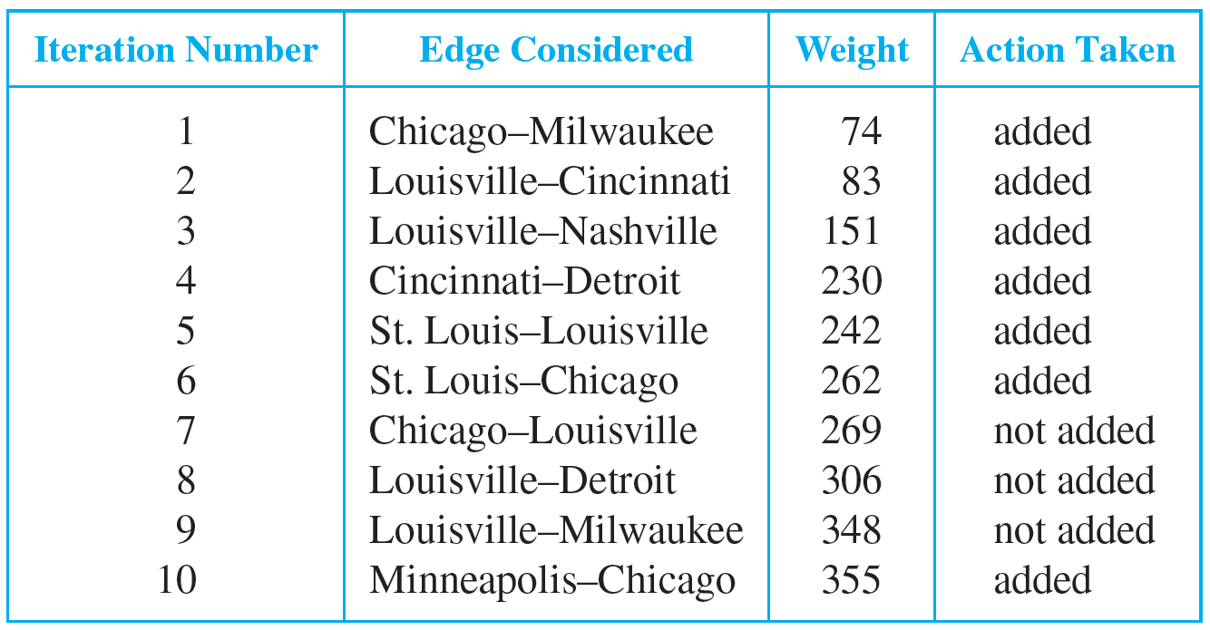
Example 10.6.2 – Solution

Slide 16
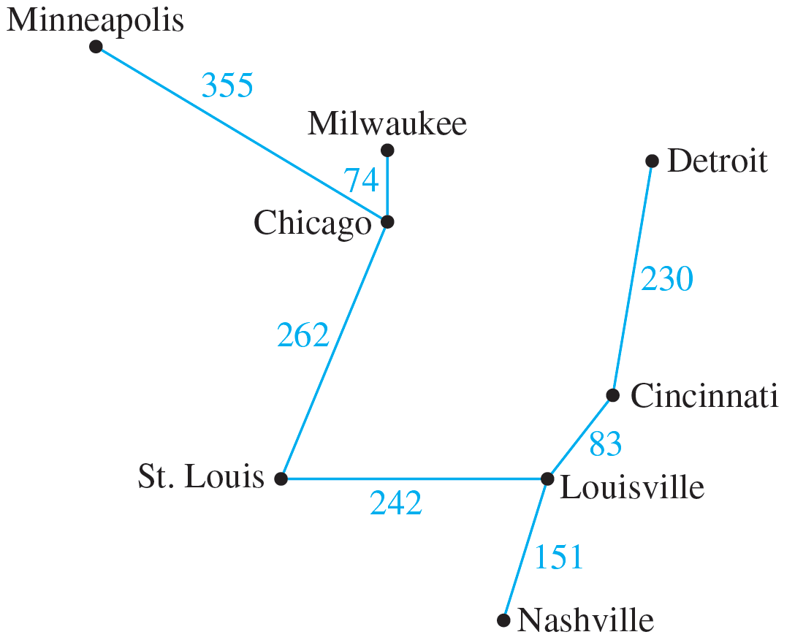
Example 10.6.2 – Solution
continued
The tree produced by Kruskal’s algorithm is shown in Figure 10.6.5.
Figure 10.6.5

Slide 17
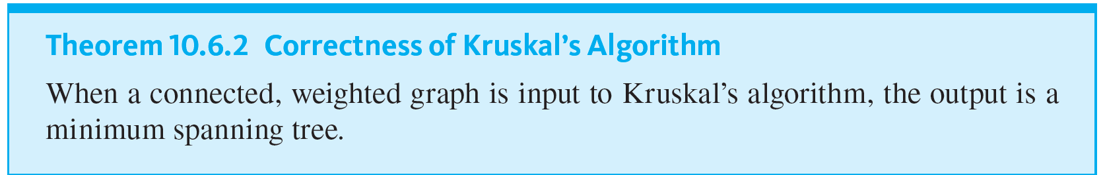
Kruskal’s Algorithm

Slide 18
Prim’s Algorithm

Slide 19
Prim’s Algorithm
Prim’s algorithm works differently from Kruskal’s. It builds a minimum spanning tree T by expanding outward in connected links from some vertex. One edge and one vertex are added at each stage.
The edge added is the one of least weight that connects the vertices already in T with those not in T, and the vertex is the endpoint of this edge that is not already in T.

Slide 20
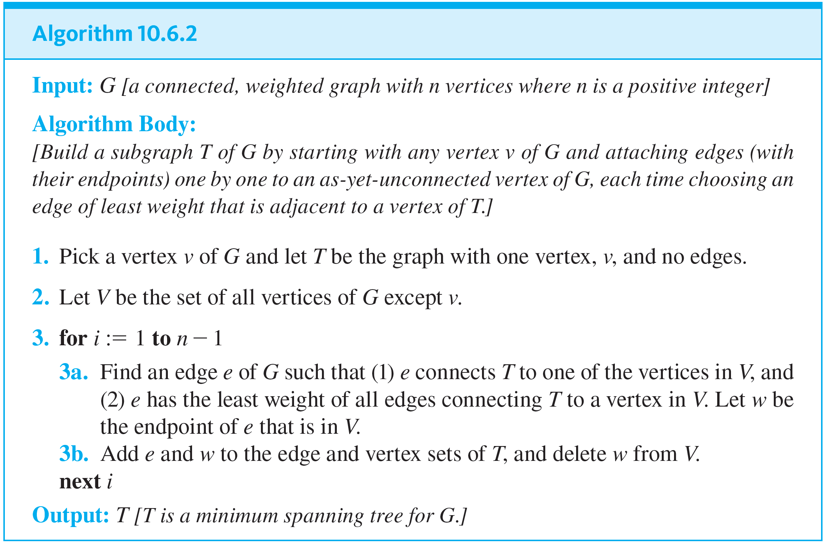
Prim’s Algorithm

Slide 21
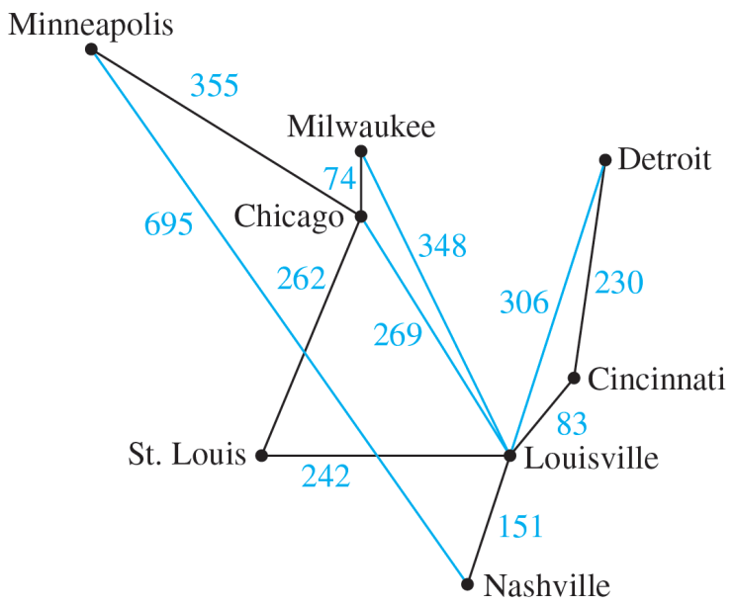
Example 10.6.3 – Action of Prim’s Algorithm
Describe the action of Prim’s algorithm for the graph in Figure 10.6.6 using the Minneapolis vertex as a starting point.
Figure 10.6.6

Slide 22
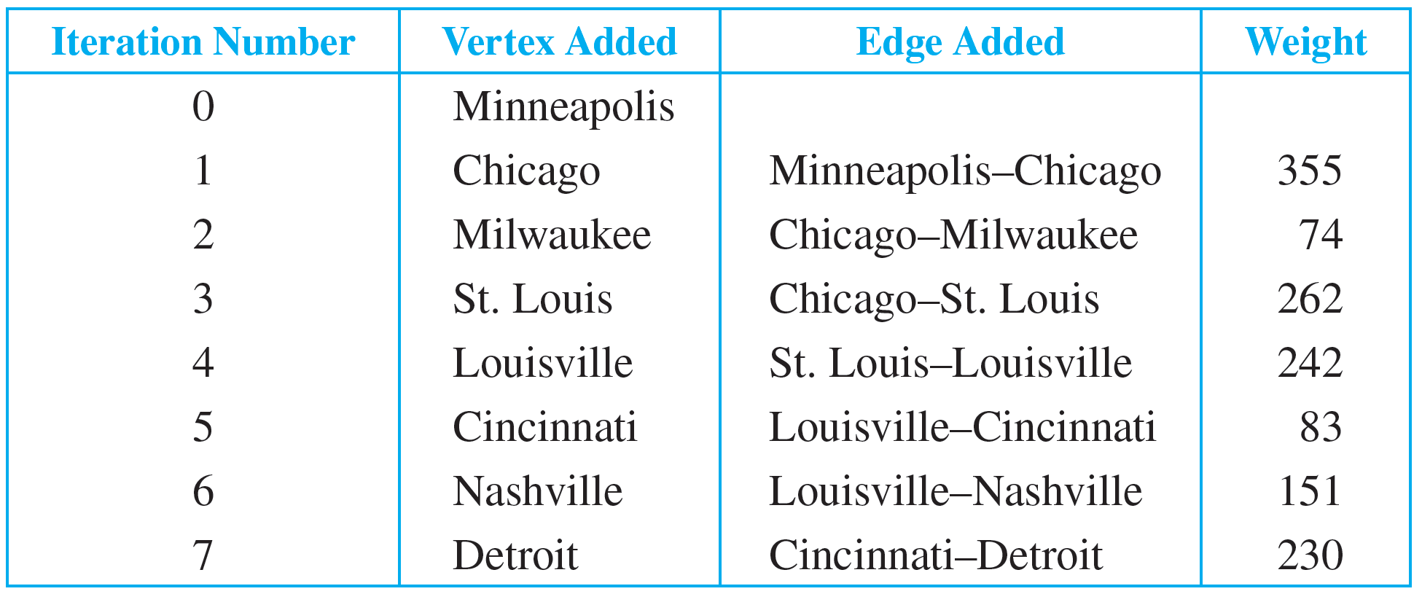
Example 10.6.3 – Solution

Slide 23
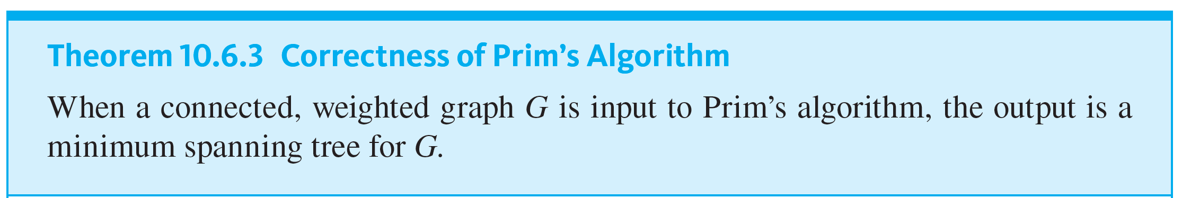
Prim’s Algorithm

Slide 24
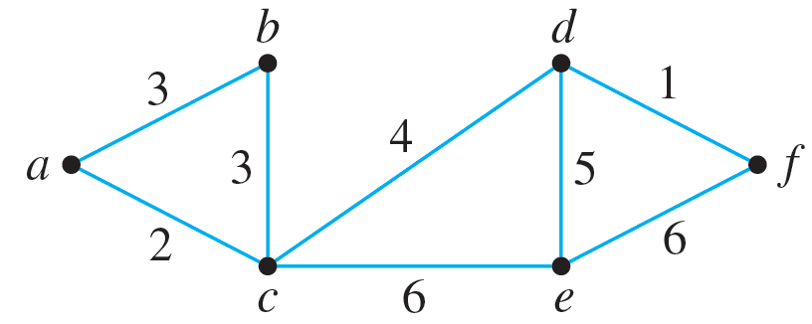
Example 10.6.4 – Finding Minimum Spanning Trees
Find all minimum spanning trees for the following graph. Use Kruskal’s algorithm and Prim’s algorithm starting at vertex a. Indicate the order in which edges are added to form each tree.

Slide 25
Example 10.6.4 – Solution
When Kruskal’s algorithm is applied, edges are added in one of the following two orders:
1. {d, f }, {a, c}, {a, b}, {c, d}, {d, e}
2. {d, f}, {a, c}, {b, c}, {c, d}, {d, e}
When Prim’s algorithm is applied starting at a, edges are added in one of the following two orders:
1. {a, c}, {a, b}, {c, d}, {d, f}, {d, e}
2. {a, c}, {b, c}, {c, d}, {d, f}, {d, e}

Slide 26
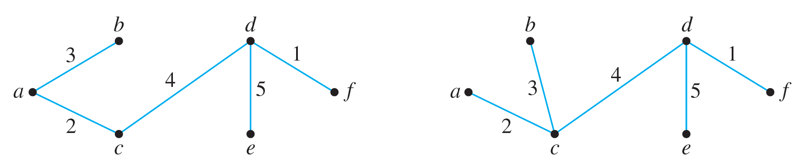
Example 10.6.4 – Solution
continued
Thus, as shown below, there are two distinct minimum spanning trees for this graph.
(a)
(b)

Slide 27
Dijkstra’s Shortest Path Algorithm

Slide 28
Dijkstra’s Shortest Path Algorithm
Although the trees produced by Kruskal’s and Prim’s algorithms have the least possible total weight compared to all other spanning trees for the given graph, they do not always reveal the shortest distance between any two points on the graph.
In 1959 the computing pioneer, Edsger Dijkstra developed an algorithm to find the shortest path between a starting vertex and an ending vertex in a weighted graph in which all the weights are positive.

Slide 29
Dijkstra’s Shortest Path Algorithm
It is somewhat similar to Prim’s algorithm in that it works outward from a starting vertex a, adding vertices and edges one by one to construct a tree T.
However, it differs from Prim’s algorithm in the way it chooses the next vertex to add, ensuring that for each added vertex v, the length of the shortest path from a to v has been identified.

Slide 30
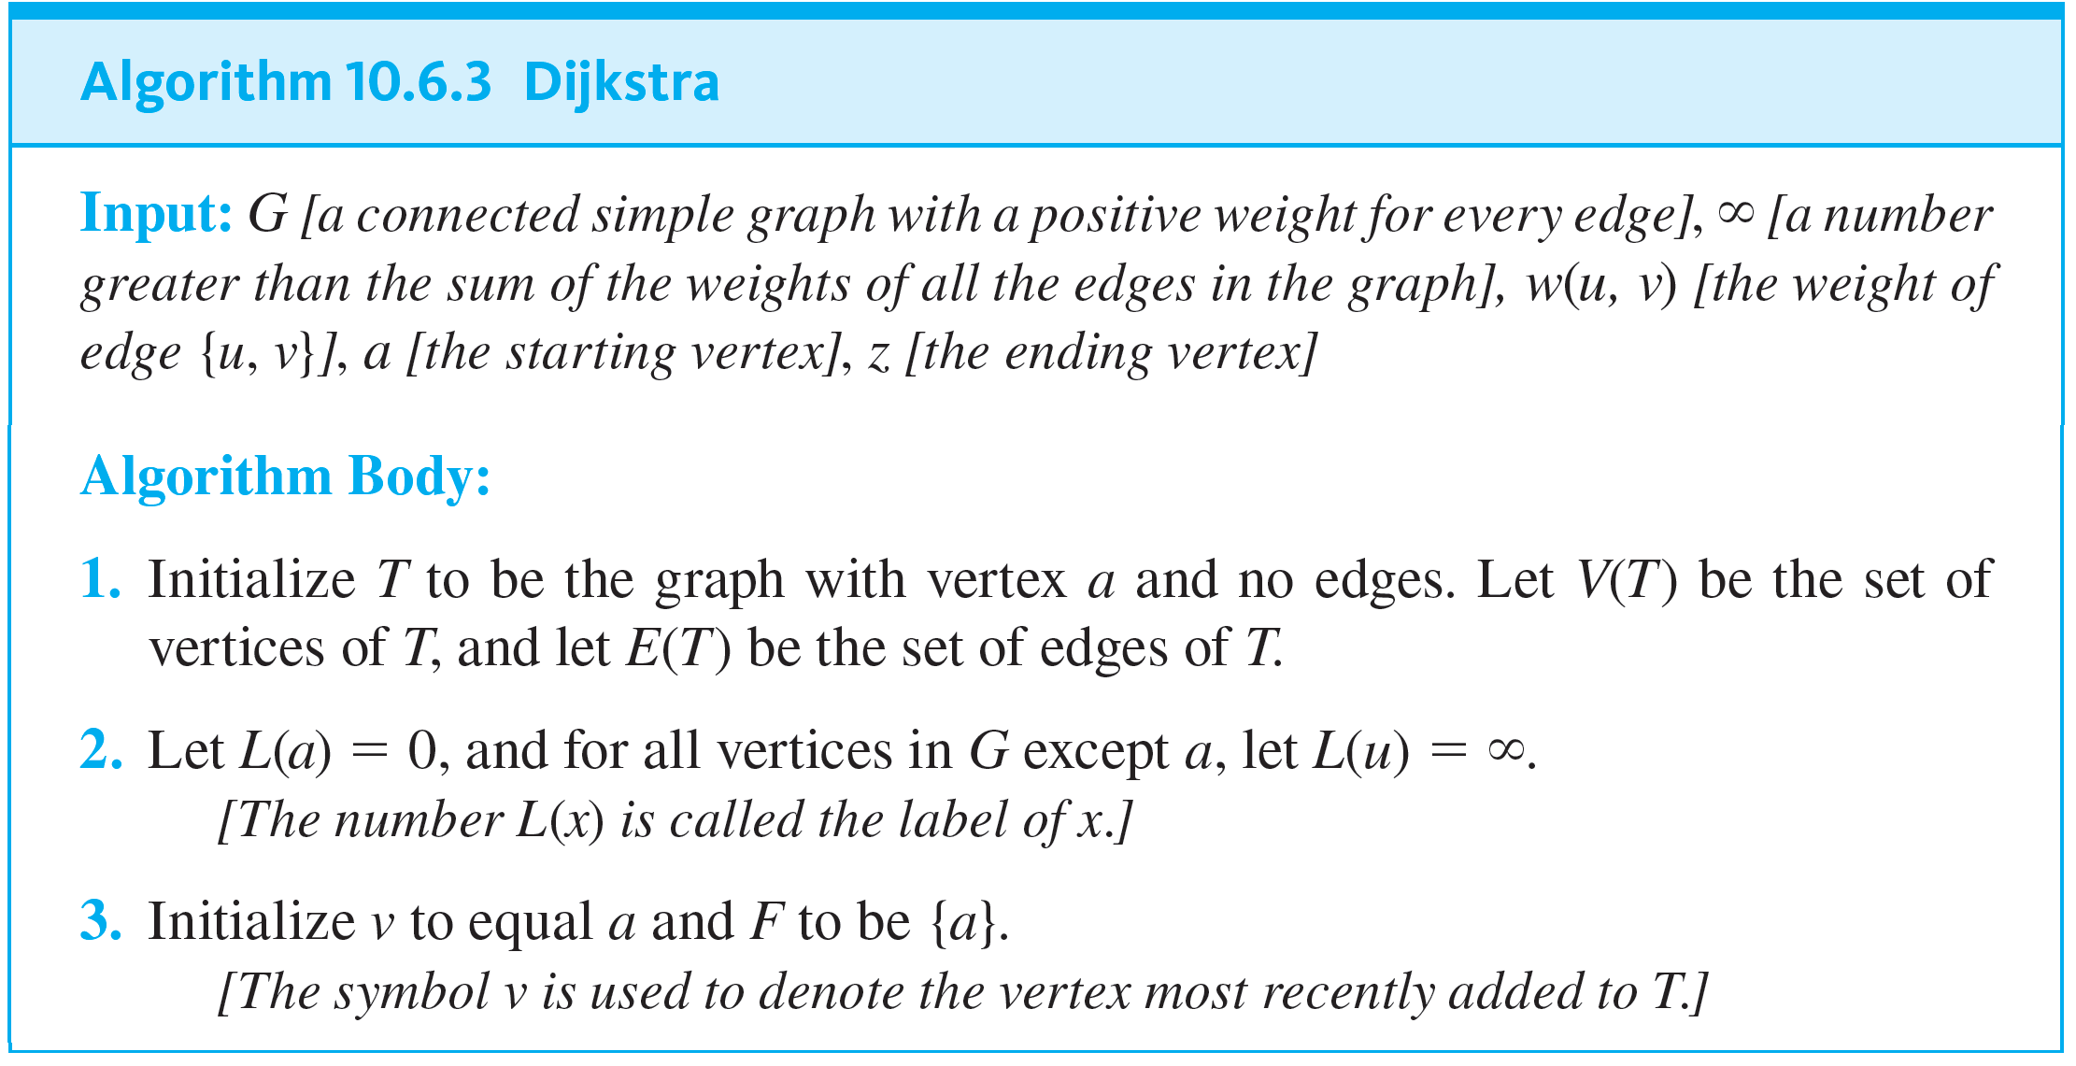
Dijkstra’s Shortest Path Algorithm

Slide 31
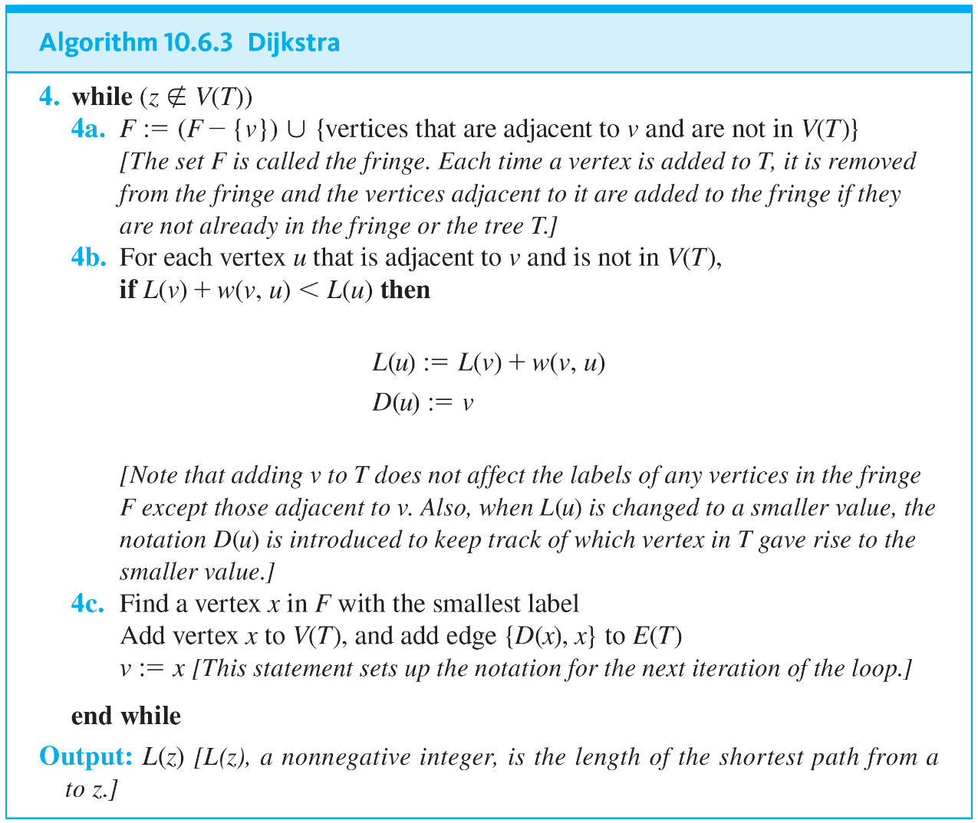
Dijkstra’s Shortest Path Algorithm
continued

Slide 32
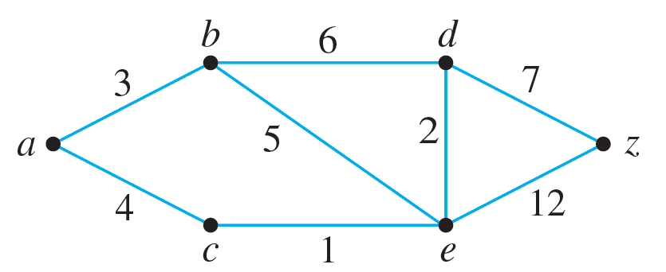
Example 10.6.5 – Action of Dijkstra’s Algorithm
Show the steps in the execution of Dijkstra’s shortest path algorithm for the graph shown below with starting vertex a and ending vertex z.

Slide 33

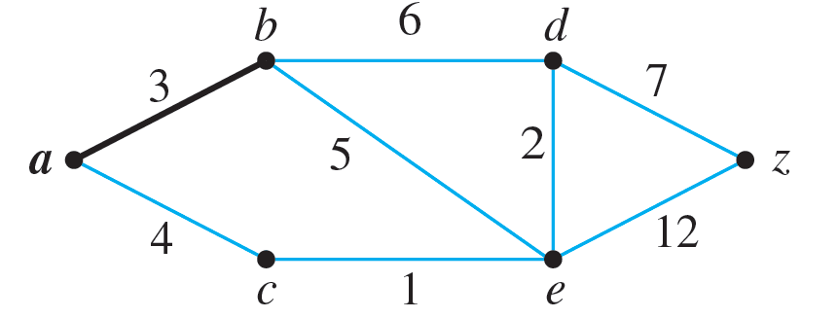
Example 10.6.5 – Solution
Step 1: Going into the while loop: V(T) = {a}, E(T) =
and F = {a}
During iteration:
F = {b, c}, L(b) = 3, L(c) = 4.
Since L(b) < L(c), b is added to V(T), D(b) = a, and {a, b} is added to E(T).

Slide 34
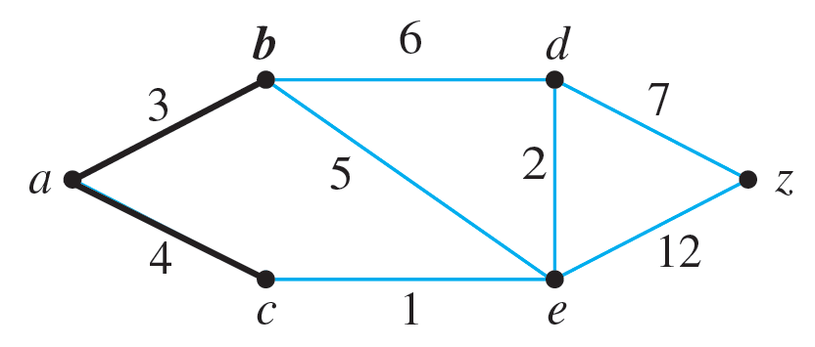
Example 10.6.5 – Solution
continued
Step 2: Going into the while loop: V(T) = {a, b},
E(T) = {{a, b}}
During iteration:
F = {c, d, e}, L(c) = 4, L(d) = 9, L(e) = 8.
Since L(c) < L(d) and L(c) < L(e), c is added to V(T), D(c) = a, and {a, c} is added to E(T).

Slide 35
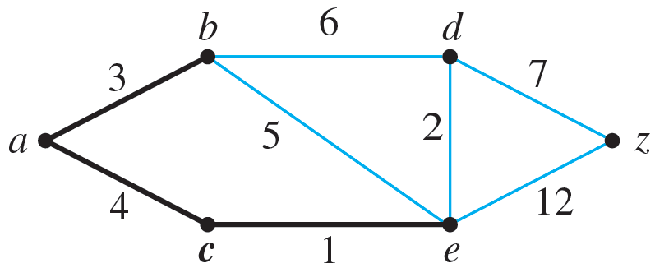
Example 10.6.5 – Solution
continued
Step 3: Going into the while loop: V(T) = {a, b, c},
E(T) = {{a, b}, {a, c}}
During iteration:
F = {d, e}, L(d) = 9, L(e) = 5 L(e) becomes 5 because ace, which has length 5, is a shorter path to e than abe, which has length 8.
Since L(e) < L(d), e is added to V(T), D(e) = c, and {c, e} is added to E(T).

Slide 36
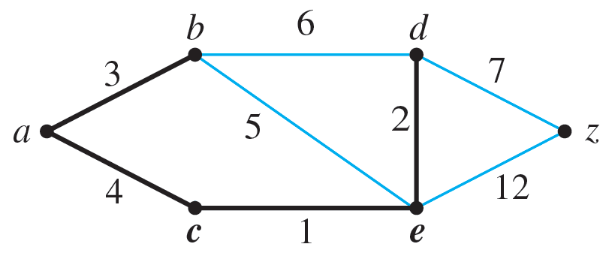
Example 10.6.5 – Solution
continued
Step 4: Going into the while loop: V(T) = {a, b, c, e},
E(T) = {{a, b}, {a, c}, {c, e}}
During iteration:
F = {d, z}, L(d) = 7, L(z) = 17 L(d) becomes 7 because a c e d, which has length 7, is a shorter path to d than a b d, which has length 9.
Since L(d) < L(z), d is added to V(T), D(d) = e, and {e, d} is added to E(T).

Slide 37
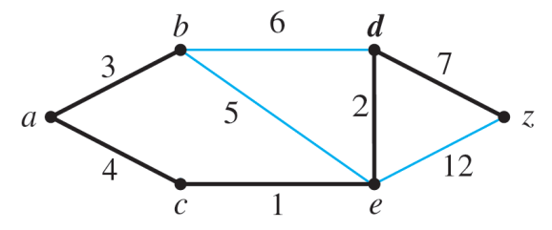
Example 10.6.5 – Solution
continued
Step 5: Going into the while loop: V(T) = {a, b, c, e, d},
E(T) = {{a, b}, {a, c}, {c, e}, {e, d}}
During iteration:
F = {z}, L(z) = 14
L(z) becomes 14 because a c e d z, which has length 14, is a shorter path to d than a b d z, which has length 17.
Since z is the only vertex in F, its label is a minimum, and so z is added to V(T), D(z) = d, and {d, z} is added to E(T).

Slide 38
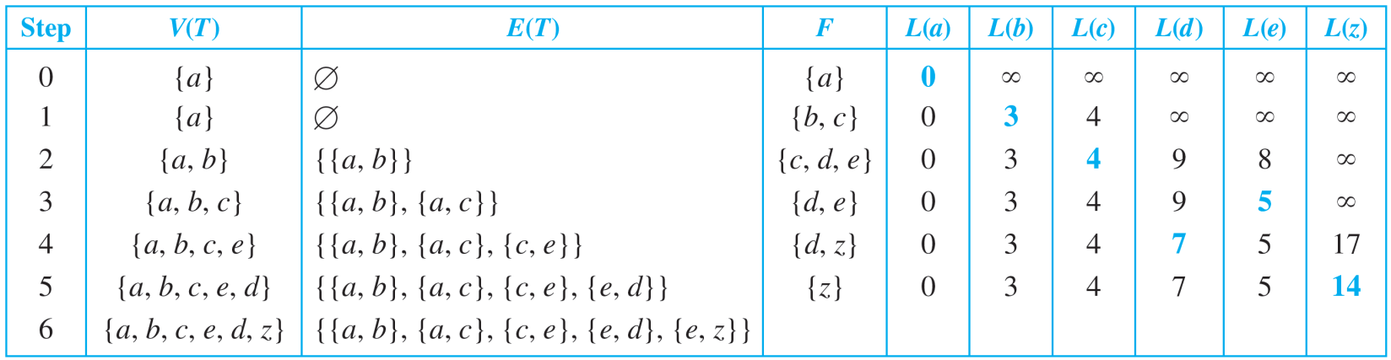
Example 10.6.5 – Solution
continued
Execution of the algorithm terminates at this point because z ∈ V(T). The shortest path from a to z has length L(z) = 14.
Keeping track of the steps in a table is a convenient way to show the action of the algorithm. Table 10.6.1 does this for the graph in Example 10.6.5.
Table 10.6.1

Slide 39
Example 10.6.5 – Solution
continued
In step 1, D(b) = a; in step 2, D(c) = a; in step 3, D(e) = c; in step 4, D(d) = e; and in step 5, D(z) = e.
Working backward gives the vertices in the shortest path. Because D(z) = d, D(d) = e, D(e) = c, and D(c) = a, the shortest path from a to z is a c e d z.

Slide 40
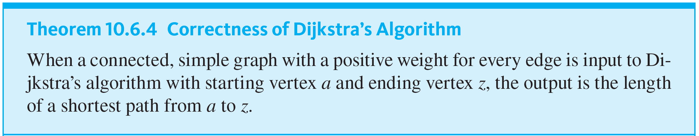
Dijkstra’s Shortest Path Algorithm

